Slide 1
Nursing Theorist: Classic Vs. Contemporary
Florence Nightingale & Jean Watson
Beth Marinelli, BScN RN
Athabasca University
Nov 1, 2024

Slide 2
Importance of Nursing Theories
Guides practice
Enhance patient care
Improve communication within the profession
Supports research and evidence-based practice
Shapes nursing education
Promotes nursing as a profession
Facilitates growth within the profession

Slide 3
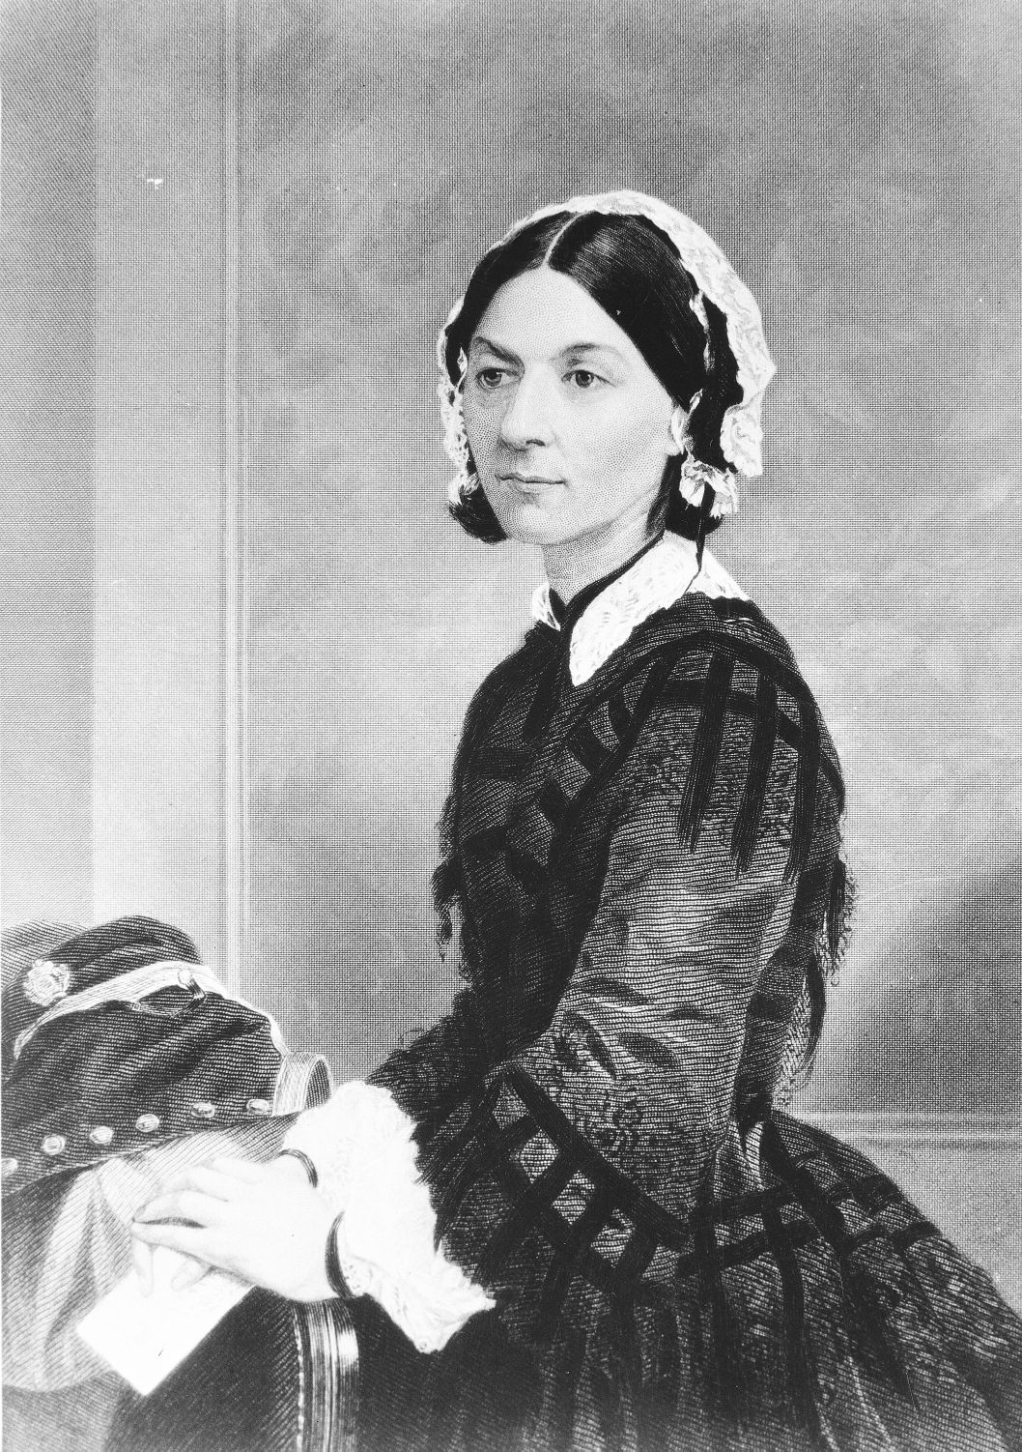
Florence Nightingale: Classic Theorist
Contributions:
Nightingale’s work established nursing as a respectable profession
Showcased the critical role of nursing in patient care
Laid the groundwork for nursing education
Reformed public health
Environmental theory
Founding nursing organizations
Literacy contributions
Background:
Born in 1820 in England
Named the Founder of modern nursing due to her work during the Crimean War

Slide 4
Nightingale’s Environmental Theory
Core Concepts
Environment: Factors such as clean air, pure water, adequate nutrition, and proper sanitation are crucial for healing.
Health: Nightingale believed that health was not just the absence of disease but a state of complete well-being
Nursing: Nurses should obtain and maintain optimal conditions to promote patient recovery
Ventilation & Warmth: proper ventilation and temperature control of essential in the healing process
Cleanliness: regular cleaning and sanitation to prevent infection and promote healing
Noise Control: controlling the noise in the environment promotes rest and recovery
Nutrition: to heal all patients require adequate nutrition
Observation: continuing to observe and assess patients the nurse will be able to alter the plan of care according to patient needs
RN, A. G., BSN. (2019, August 22). Florence Nightingale’s Biography and Environmental Theory: Study Guide. Nurseslabs. https://nurseslabs.com/florence-nightingales-environmental-theory/#h-major-concepts-of-florence-nightingales-theory

Slide 5

Jean Watson: Contemporary Theorist
Contributions:
Theory of Human Caring
Carative Factors- essential elements of caring
Transpersonal caring relationships- importance of nurse patient relationship
Holistic nursing practice
Established the field of caring science
Literacy contributions
Background:
Born 1940 in USA
Renowned for her work in caring science

Slide 6
Watson’s Theory of Human Caring
Core Concepts:
Society: provides values on a person should behave and what goals to push for
Human Being: a valued person to be cared for, respected, nurtured, understood, and assisted
Health: Physical, mental, and social well-being.
Nursing: a human science of persons and human health-illness experiences mediated by professional, personal, scientific, esthetic, and ethical human care transactions.
Gonzalo, A. (2016, January 5). Jean Watson: Theory of Human Caring. Nurseslabs. https://nurseslabs.com/jean-watsons-philosophy-theory-transpersonal-caring/#h-theory-of-human-caring-of-jean-watson

Slide 7
Comparison of Theories:
Aspects | Florence Nightingale | Jean Watson
Focus | Environment & Sanitation | Caring & Relationships
Historical Context | 19th-Centurary, Post Crimean War | Late 20th-Centurary, Modern Healthcare
Impact on Nursing | Professionalization of Nursing | Emphasis on Holistic Care
Key Elements | Cleanliness, fresh air, nutrition | Caring moments, Transpersonal Caring

Slide 8
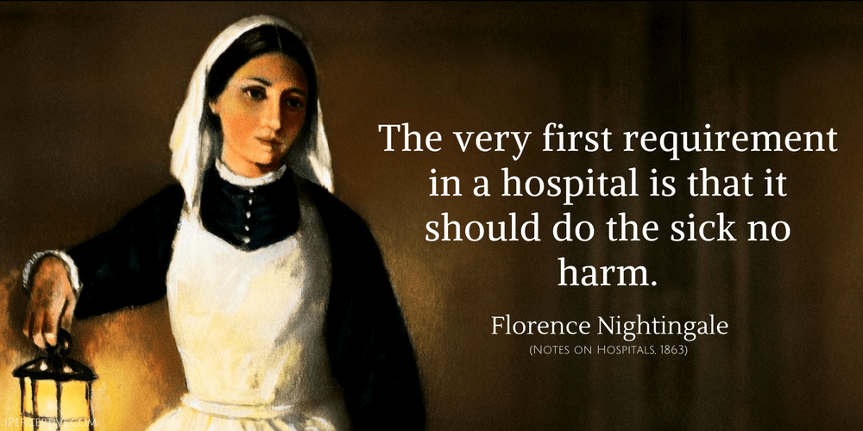
Comparison of Theories:
Similarities
Recognition of patients needs
Influence on nursing education
Advocacy and improvement of patient outcomes
Differences
Focus areas:
Nightingale: environment
Watson: caring
Philosophical Foundations
Nightingale: Pragmatic approach
Watson: Philosophical & Ethical Stance

Slide 9
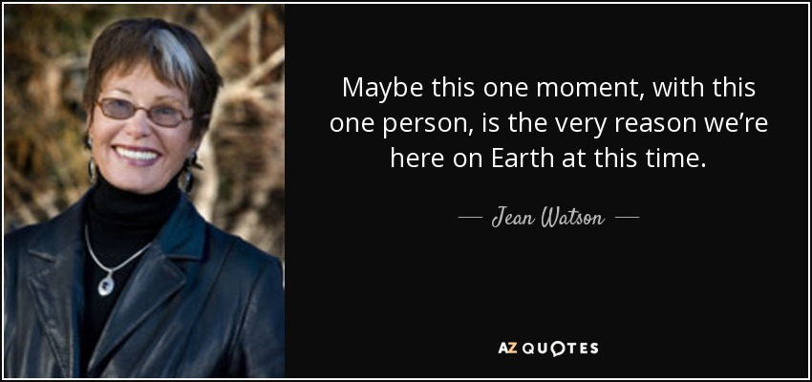
Conclusion
Nightingale laid the groundwork for the nursing profession
Watson expanded the meaning of nursing to include emotional and spiritual aspects
Together, their legacies continue to influence nursing education and practice, guiding nurses to provide comprehensive and empathetic care that addresses both physical and emotional needs.

Slide 10
References
Gonzalo, A. (2016, January 5). Jean Watson: Theory of Human Caring. Nurseslabs. https://nurseslabs.com/jean-watsons-philosophy-theory-transpersonal-caring/#h-theory-of-human-caring-of-jean-watson
Hegge M. Nightingale’s Environmental Theory. Nursing Science Quarterly. 2013;26(3):211-219. doi:10.1177/0894318413489255
WATSON, J. (2008). Nursing: The Philosophy and Science of Caring, Revised Edition. University Press of Colorado. http://www.jstor.org/stable/j.ctt1d8h9wn
RN, A. G., BSN. (2019, August 22). Florence Nightingale’s Biography and Environmental Theory: Study Guide. Nurseslabs. https://nurseslabs.com/florence-nightingales-environmental-theory/#h-major-concepts-of-florence-nightingales-theory
Zborowsky T. The Legacy of Florence Nightingale’s Environmental Theory: Nursing Research Focusing on the Impact of Healthcare Environments. HERD: Health Environments Research & Design Journal. 2014;7(4):19-34. doi:10.1177/193758671400700404

